Slide 1
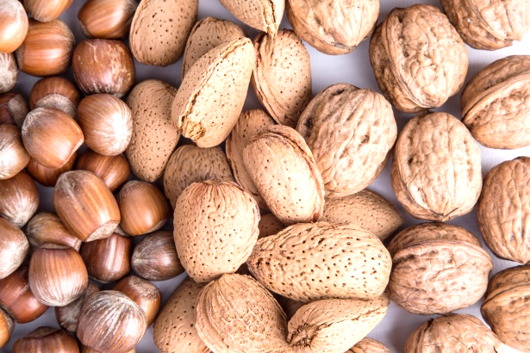
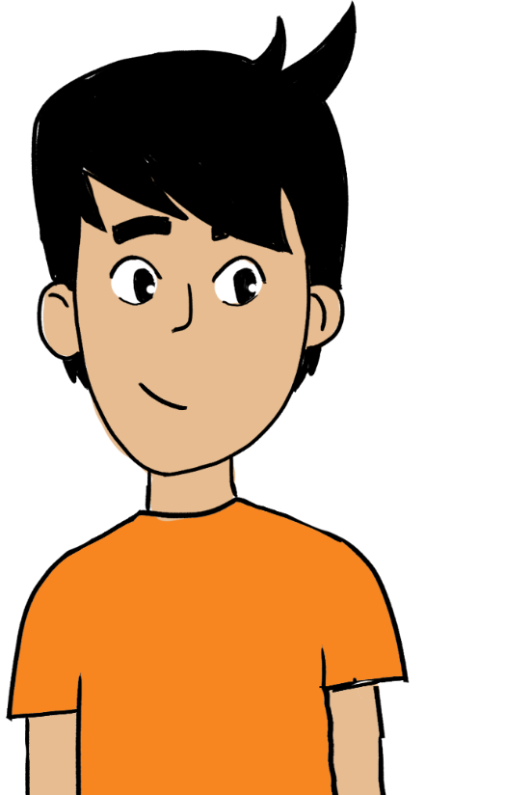

Know your nuts!
Testicular health

Slide 2
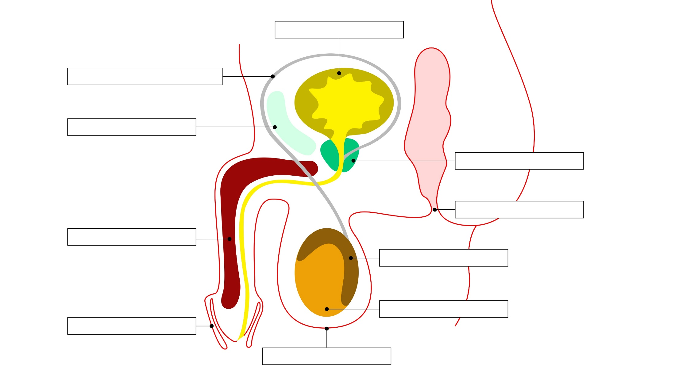
See how many structures you recognise,
then fill in your worksheets when you get them!

Slide 3
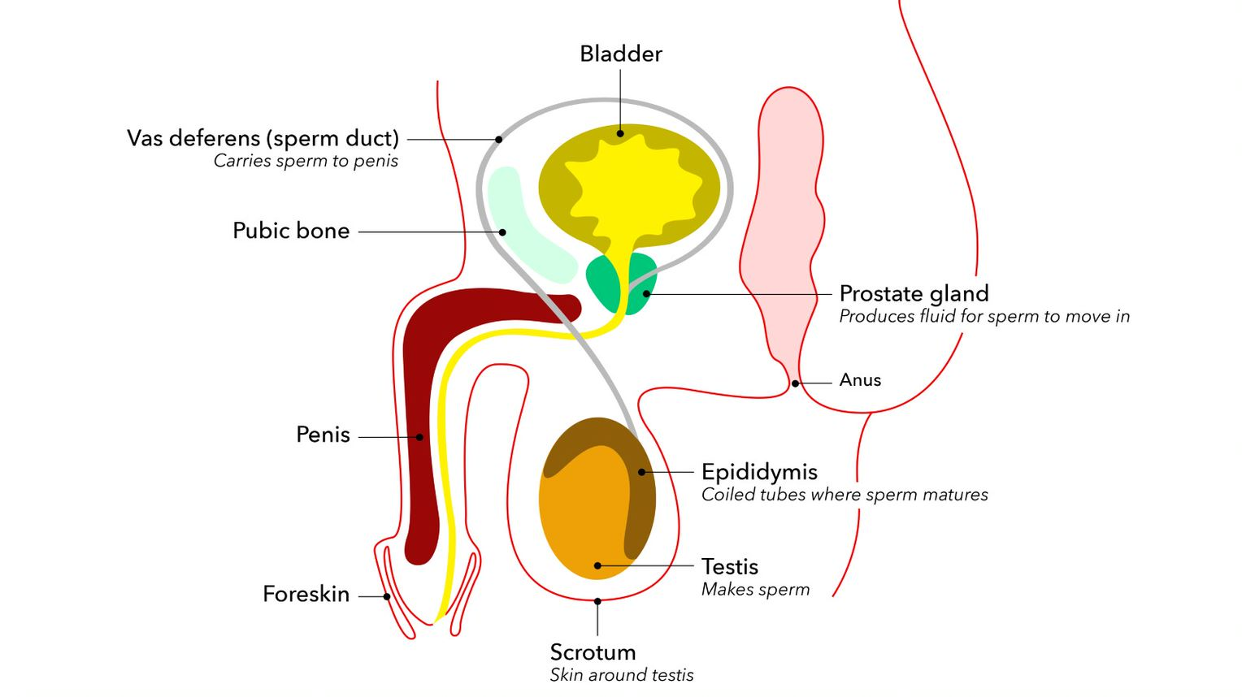
What do you know/remember about male reproductive anatomy? Check your labels!

Slide 4
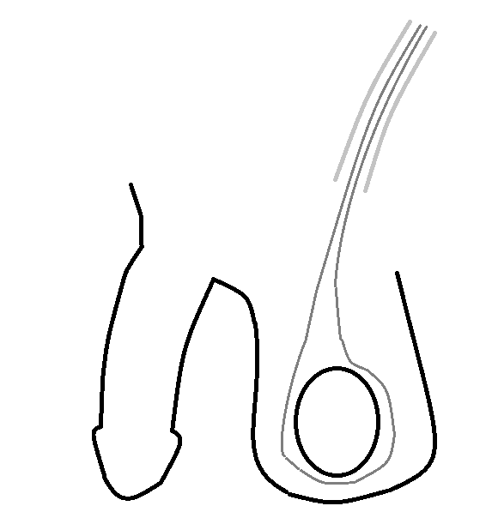
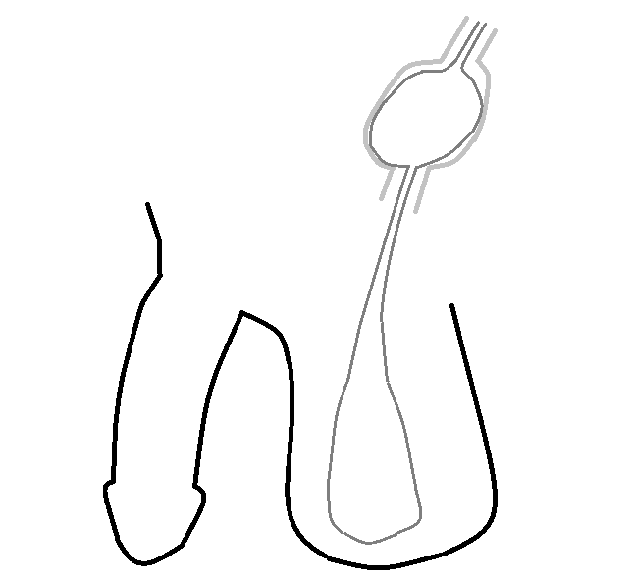
During development in the womb…
In most male foetuses, testes form within the abdomen and descend/drop down into the scrotum via a tunnel called the inguinal canal. This usually happens before birth or soon after.
Inguinal canal
In foetus
In baby
descending testis
testis in scrotum
It’s normal for one testis to be slightly larger than the other,
and for one to hang lower than the other within the scrotum

Slide 5
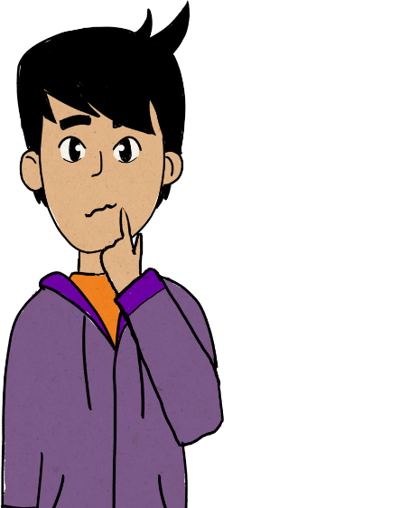
Things don’t always go according to plan….
Sometimes, a testis can get ‘stuck’ part-way down the canal. If it stays here, fertility can be affected later.
Undescended testes are usually sorted out by a specialised doctor (a paediatric surgeon or urologist) early in childhood.
Some boys have testes that retract a bit (ie. go part of the way back inside) when they are aroused or cold. This is not usually anything to worry about.
  However, if it causes discomfort or the testes retract right out of the scrotum often, this should be checked out to be sure everything is okay.

Slide 6
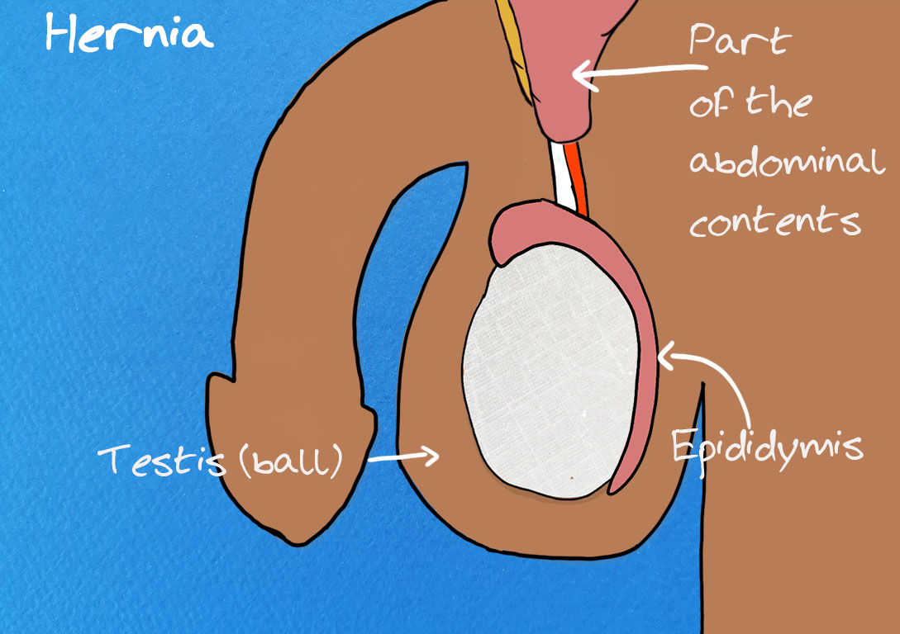
What’s a Hernia?
Some boys and men get inguinal hernias – this is when part of the abdomen or intestine pushes out through a weak bit of the canal or nearby and makes a visible bump in the groin (the ‘groove’ where your leg meets your pubic region):
  it sometimes sorts itself out…
  but often needs the help of a doctor to repair the weak patch, especially if a bit of intestine gets stuck in there (you’d know if this happened – it’s really sore!)
  doctors can fix these quite easily if they aren’t left too long

Slide 7

Torsion
Does anyone know what torsion means?
(If you’re keen on physics, you may have heard of the word.)
  = twisting
Testicular torsion happens when the testis twists inside the scrotum.
  In most boys, this can’t happen because it’s well attached and not very mobile,
  but around 1 in 4000 boys/men under the age of 25 will experience testicular torsion each year. It is less common in older men.
This is what a healthy testis looks like, then what happens when the testis twists:
    Watch this short video.
    (https://youtu.be/z7k6dRfPEYc What is testicular torsion video)

Slide 8
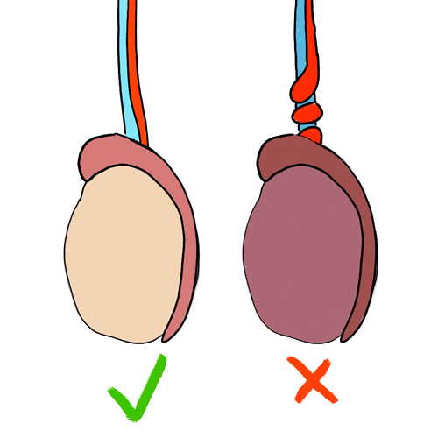
Why is testicular torsion a potential problem?
In pairs or small groups, try to answer the following 5 questions on your worksheet:
What did you see happening in the animation?
Why is this a problem?
What do you think the symptoms might be?
What do you think a boy/young man should do if he suspects torsion?
How worried should we be about testicular torsion?

Slide 9
Now watch this video*
You may want to add to your answers to the previous questions while/after you watch:
What did you see happening in the animation?
Why is this a problem?
What do you think the symptoms might be?
What do you think a boy/young man should do if he suspects torsion?
How worried should we be about testicular torsion?
* https://youtu.be/r7cquMUdE10 More information about torsion video

Slide 10
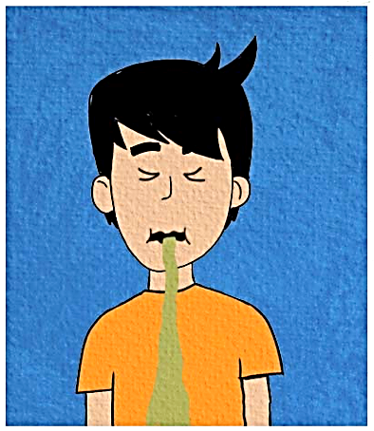
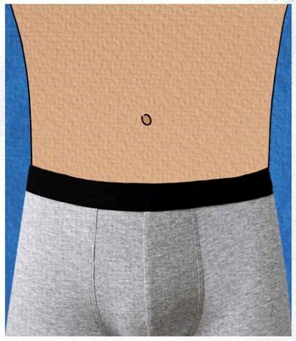
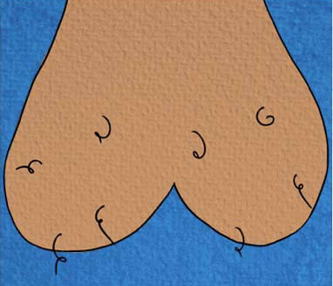
Consolidation of your Answers:
The twisting of the cord is preventing blood from reaching the testis.
Without fresh blood, the testis will eventually die.
This takes a few hours.
If a testis dies, this may reduce fertility (the chances of fathering a child) later on.
Key symptoms are pain in one testis (it’s relatively rare for both to be affected at the same time).
NB: this may or may not be severe pain.
Some redness and swelling may occur, but not immediately.
Nausea and vomiting may occur, but often don’t.
Some boys/men feel pain in their lower belly before/without any testis pain.

Slide 11
More answers
H
A & E
If one-sided (unilateral) testicular pain is experienced, and it doesn’t go away after an hour, you should see an emergency doctor as soon as possible, ideally at a hospital with child/paediatric casualty (an A&E section especially for under 18s).
It usually takes around 6 hours or so for lasting damage to occur, so the quicker you seek help, the less chance there is of losing a testis and having to have it removed.
Torsion is not common – remember, only around 1 in 4000 young men experience it each year. It’s also relatively easy to sort out if you act fast, so it’s not a big deal unless you ignore it. Don't be shy about checking it out!!!

Slide 12
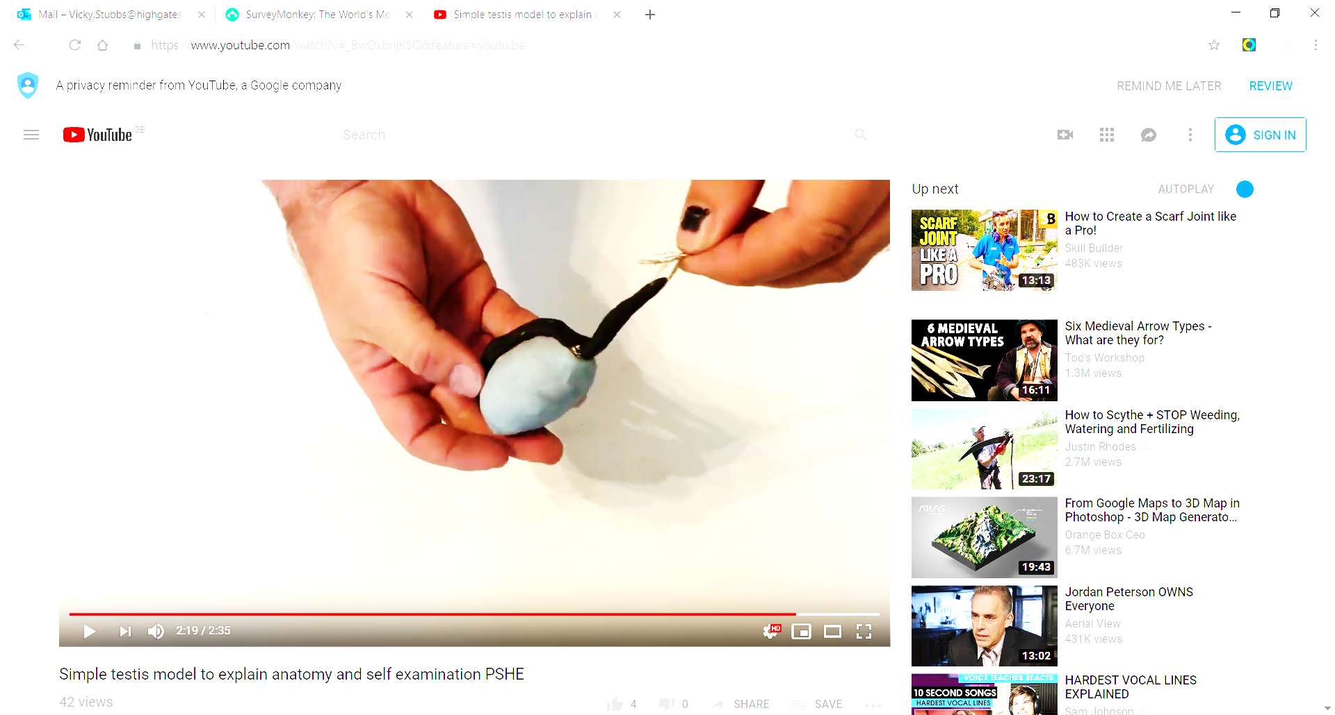
Make or pass around a model testis!
Watch the demonstration by your teacher or use the instructions provided.
Your teacher may pass around a model testis or guide you to make one out of clay and thread, and place a small bead on one side of the ‘testis’.
The model testis sitting inside 2 small plastic bags a bit like a real testis in the scrotum. Now feel how the clay testis moves within the bag.
Can you feel the difference in texture between the bead and the clay through the bag? What do you think the seed/bead represents?

Slide 13
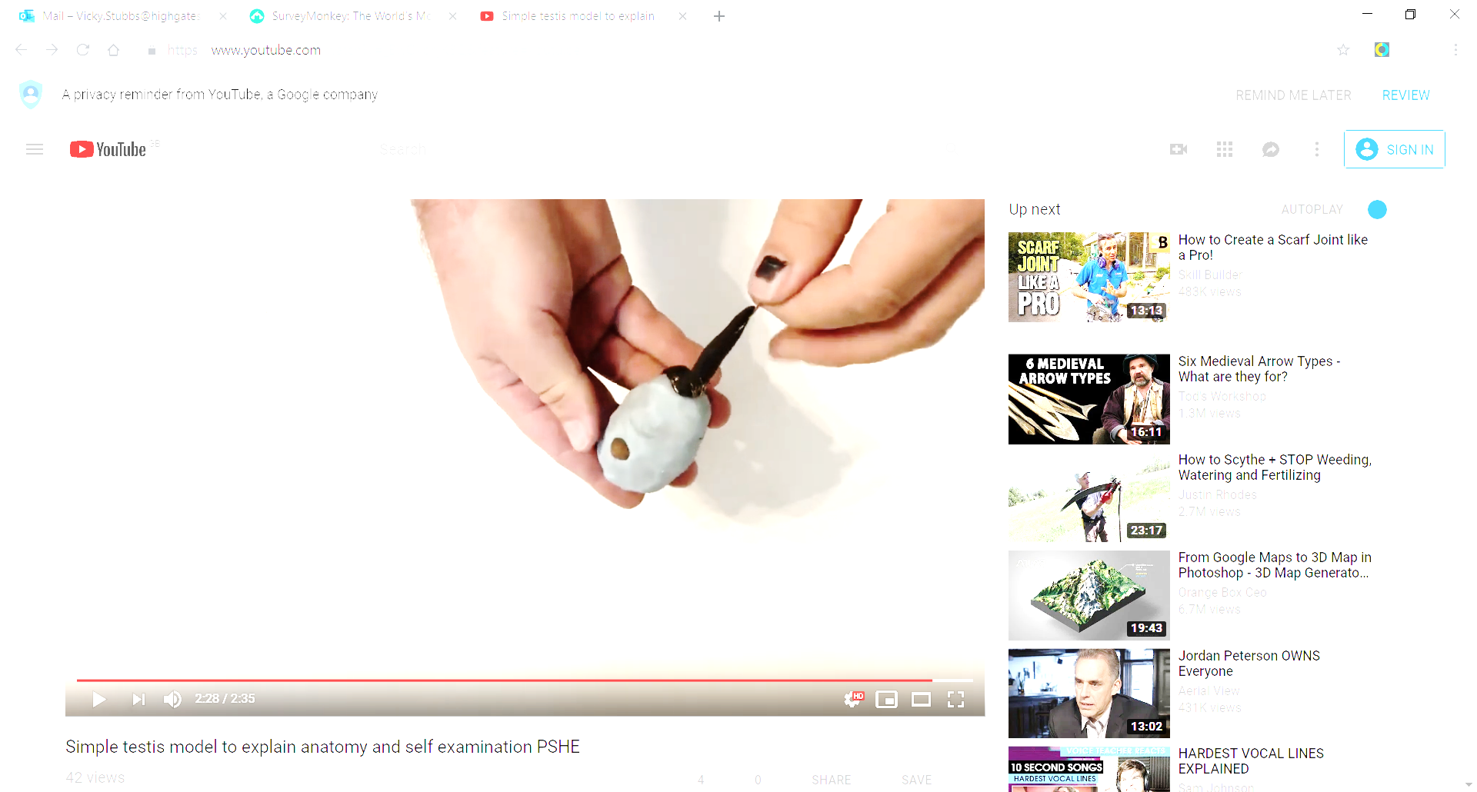

Testicular cancer
Usually, the first thing people notice is a small, hard lump on the testis.
Some people also notice that one testis changes in size or shape.
Many lumps aren’t cancer, but it’s wise to get a lump checked out by a doctor, to be sure.
It’s not very common: around 1 in 12000 UK males are diagnosed with testicular cancer each year.
When diagnosed at its earliest stage, all men with testicular cancer will survive their disease for five years or more*. 98% survive for 10 years or more.
It is not clearly linked to any preventable risk factors.
* A standard time measurement for cancer survival (stats from Cancer Research UK and NCIN)

Slide 14
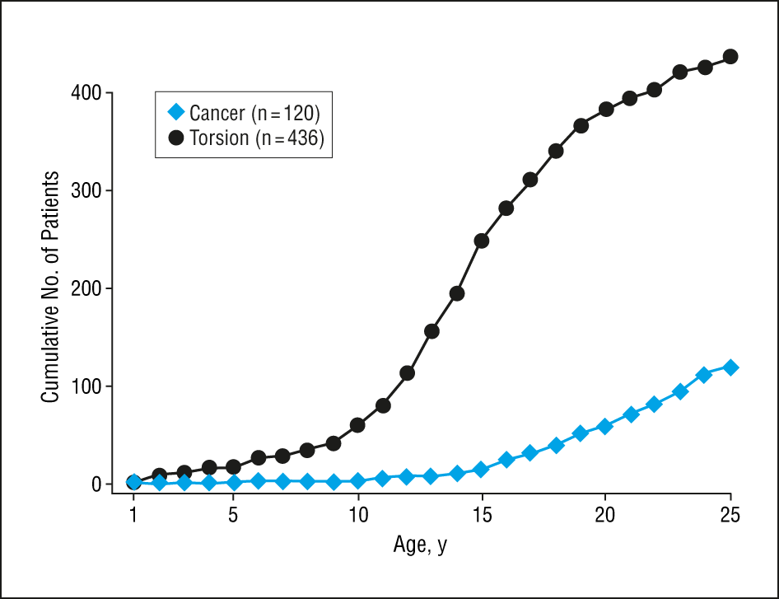

Why are we learning about this now?
Graph indicating the age at which testicular torsion and testicular cancer are most likely to occur (data from the USA)
What do you notice about the age of patients where the lines are steepest?
Although neither occurs frequently, which is more common in boys and young men, testicular cancer or torsion?
(In the UK, testicular cancer is most commonly diagnosed between 30-34y)
Cumulative number of patients with testicular torsion and with testicular cancer.
Copyright © 2005 American Medical Association. All rights reserved.
Arch Pediatr Adolesc Med. 2005;159(12):1167-1171. doi:10.1001/archpedi.159.12.1167
Notes:
Teachers’ notes: Torsion is more common. T cancer is very rare before puberty and becomes more common afterward; it is most commonly diagnosed in young and middle-aged men but can occur at any age. 86% of testicular torsion cases occur in males older than 10 years (median age, 15 years), while 82% of testicular cancer cases occur in males older than 15 years (median age, 20 years).
Source: Jonathan M. Mansbach, MD; Peter Forbes, MA; Craig Peters, MD
Arch Pediatr Adolesc Med. 2005;159(12):1167-1171. doi:10.1001/archpedi.159.12.1167

Slide 15
In the unlikely event that someone develops testicular cancer, how can they ensure it’s caught early?
Check testes at least once a month. It’s much easier to remember if checking is done at every bath or shower time when testes are washed anyway.
While it’s not often a problem, having an undescended testis can make that testis a bit more vulnerable to testicular cancer.
  If one or both testes seem to be missing from the scrotum, it’s best to get this checked out with a doctor to be sure everything is okay.
Watch this testicular self-exam clip*.
Who could a person talk to if they think they find a lump?
    - Parent/guardian; doctor; school nurse.
* https://youtu.be/CEFsKSOJdhY Testicular lumps 4 minute video

Slide 16

Now test your knowledge with a game or quiz…..

Slide 17
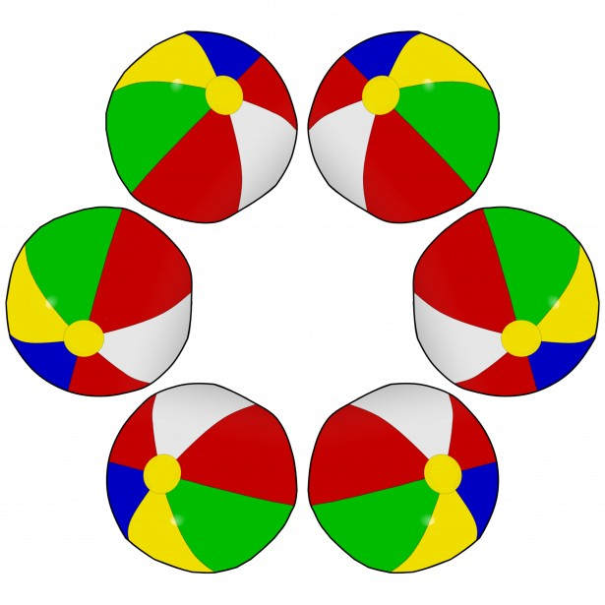
Ball game: a little testicle
How much have you learned?
Divide the class into two teams.
Stand in two lines facing each other.
One person starts and tosses the ball/beanbag to someone in the other team.
That person has to answer a question the teacher reads out, to get a point for their team.
(If they can’t answer it, they can pass.)
Then they toss the ball to a member of the other team, and so on.
Try not to pass to someone who has already answered a question till everyone has had a go.

Slide 18
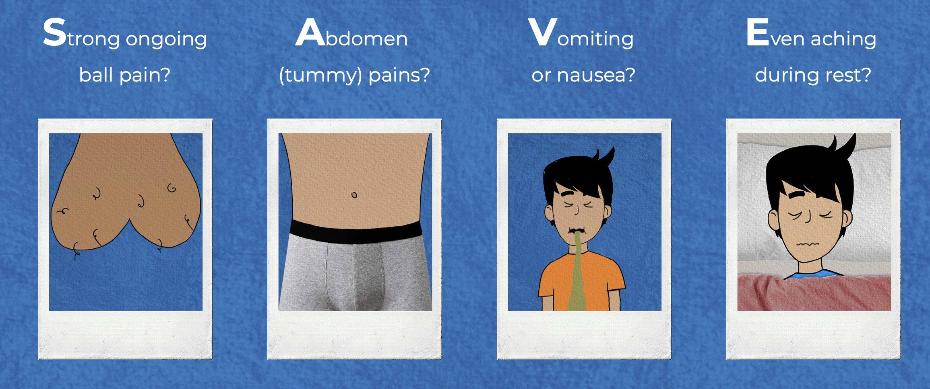
Act fast to SAVE the ball!

Slide 19

Making a model testis
Take an egg-sized chunk of modelling clay and mould it into an egg shaped ‘testis’.
Take a strip of modelling clay and wrap it round a piece of string.
Pop the ‘testis’ into 2 mini plastic bags to represent the scrotum.
Firmly press the wrapped string along one side of the egg-shaped ‘testis’. The clay-covered string represents the epididymis, where sperm mature.
Now dangle the ‘testis’ on the string. See how it can twist and turn?
Press a hard bead/seed halfway into the ‘testis’ on the opposite side to the covered string.
Can you feel the difference between the ‘testis’ and the bead?

Slide 20
Credits:
Original concept and design: Professor James Green and Charlie Green
Lesson structure, lesson design and pilot testing: Dr Vicky Stubbs, Highgate School, London.
Clinical content: Professor James Green, Urology Network Director, North East London, and contributing surgeons (torsion) Nadine McCauley, Caroline MacDonald and Shabnan Undre and (testicular lumps and self examination) Ashley Mehmi.
Script development, graphic design and video animation: Sophia Ppali and Imran Nazerali.

Slide 21

Key Words
Scan here for more information on testicular health.
Testis (one)…..testes (two)
Testis = testicle = ‘ball’
Scrotum = the proper word for a ‘ballsack’
Torsion (twisting)
Abdomen = lower part of tummy
Paediatric = the branch of medicine or part of a hospital that deals with children
Cancer = a lump (of cells) in your body that can make you quite ill if left untreated

